Slide 1
Computer Graphics ray tracing final Projects
László Szécsi szecsi@iit.bme.hu
AIT

Slide 2
Participating media

Slide 3
Fog – volumetric effects
radiance diminishes as light travels in medium
must maintain attenuation coefficient while tracing light path
it matters if the ray exits the medium of stays inside

Slide 4


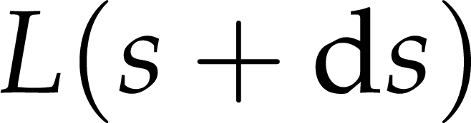
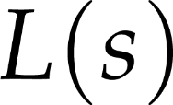
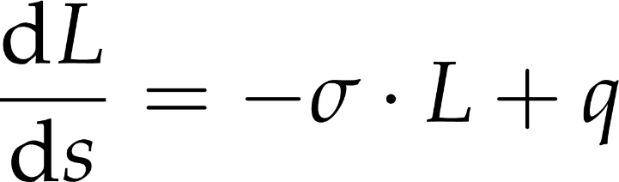
Differential eq.
absorption
attenuation
outscattering
emission
source
rate of change of radiance
inscattering
attenuation coefficient (RGB)
source term (RGB)
per unit length along the ray
radiance right there (RGB)

Slide 5

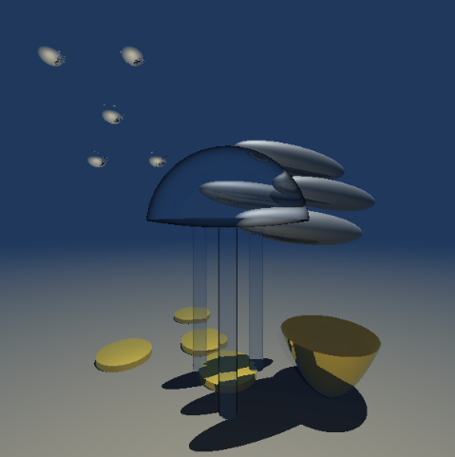
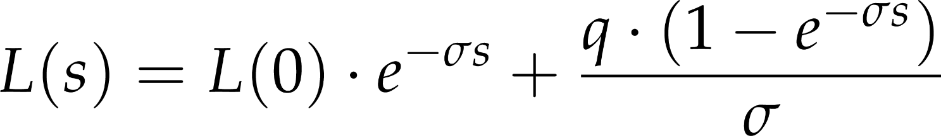
Solution
some light is absorbed
colored glass, gemstone
fog, smoke, murky water
solution of differential equation:
percentage lost
radiance at ray hit
radiance at ray origin,
at distance from hit
plus radiance gathered

Slide 6
Ray Marching AND Metaballs

Slide 7
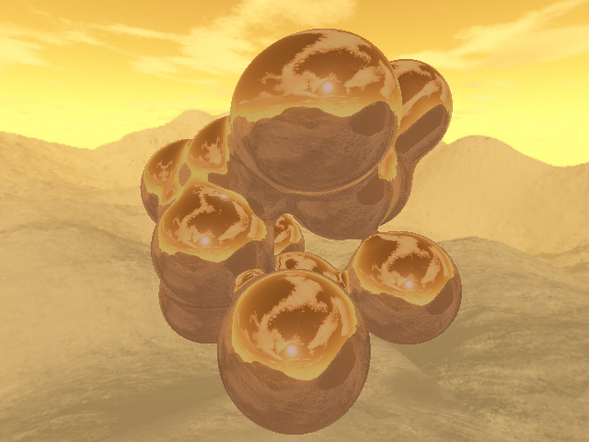
Metaballs

Slide 8
Implicit surface equation is a sum of radial basis functions centered at 3D points
f
t
-A

Slide 9
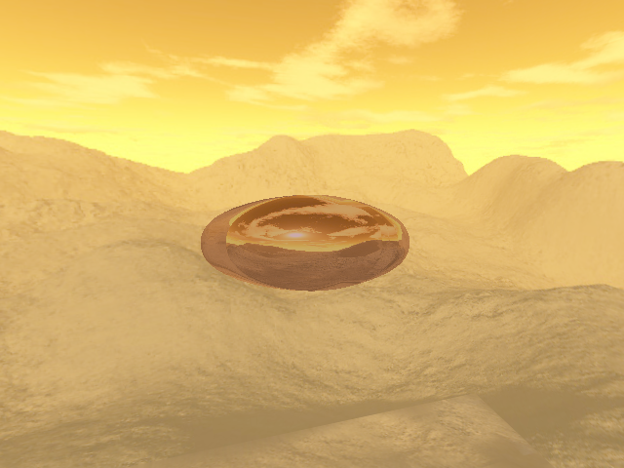
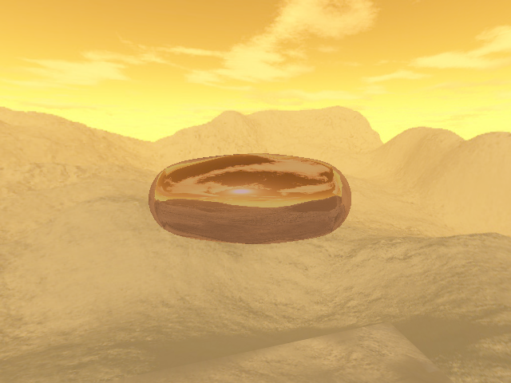
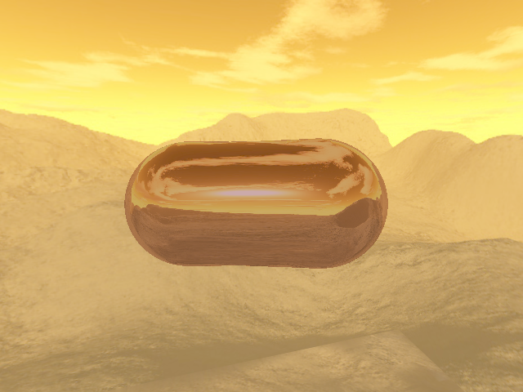
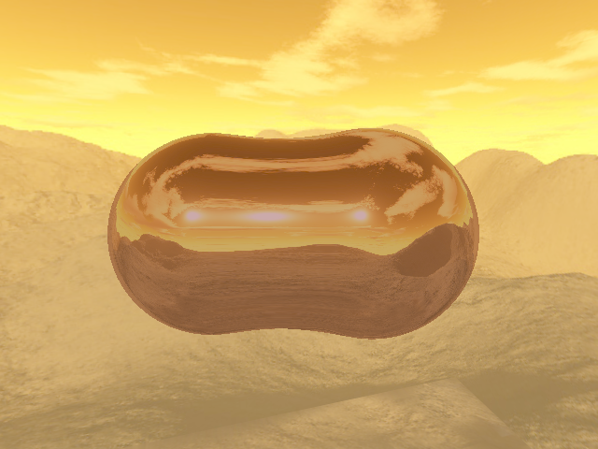
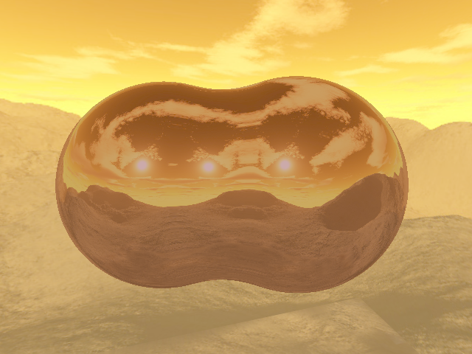
Different values of A (isosurface level)

Slide 10
Alternatives for the radial basis function
Blinn
Perlin
Wyvill
f
r
if r > 1, then 0
if r > 1, then 0

Slide 11
Ray marching
f
t

Slide 12
Linear search for intersection (ray marching)
Step until first point inside

Slide 13
Ray marching
vec3 p = eye + d * tstart;
vec3 step =
d * min((tend - tstart)/128.0, 0.05);
float h;
for(int i=0; i<128; i++){
h = noise(p);
if(h > 0.0) break;
p += step;
}

Slide 14
Binary search

Slide 15
Refining ray marching results with binary search
step size becomes half the step of the last ray marching step
search starting point halfway between last two ray marching points
the step size we just computed also helps in finding the halfway point
in a loop (say 16x)
if we are outside, step ahead
if we are inside, step back
reduce the step size two its half

Slide 16
Metaball normal – for shading
gradient: vector of partial derivatives
partial derivatives of basis function added
normalized

Slide 17
Surface normal – any implicit surface
find gradient
approximate partial derivatives using central differences
df(r)/dx = f(r+(ε, 0, 0)) - f(r-(ε, 0, 0))
then normalize

Slide 18
Gradient from differences
vec3 gradient = vec3(
noise(p + vec3(+0.05, 0.0, 0.0) ) -
noise(p + vec3(-0.05, 0.0, 0.0) ) ,
noise(p + vec3(0.0, +0.05, 0.0) ) -
noise(p + vec3(0.0, -0.05, 0.0) ) ,
noise(p + vec3(0.0, 0.0, +0.05) ) -
noise(p + vec3(0.0, 0.0, -0.05) )
);
vec3 normal = normalize(gradient);

